Slide 1


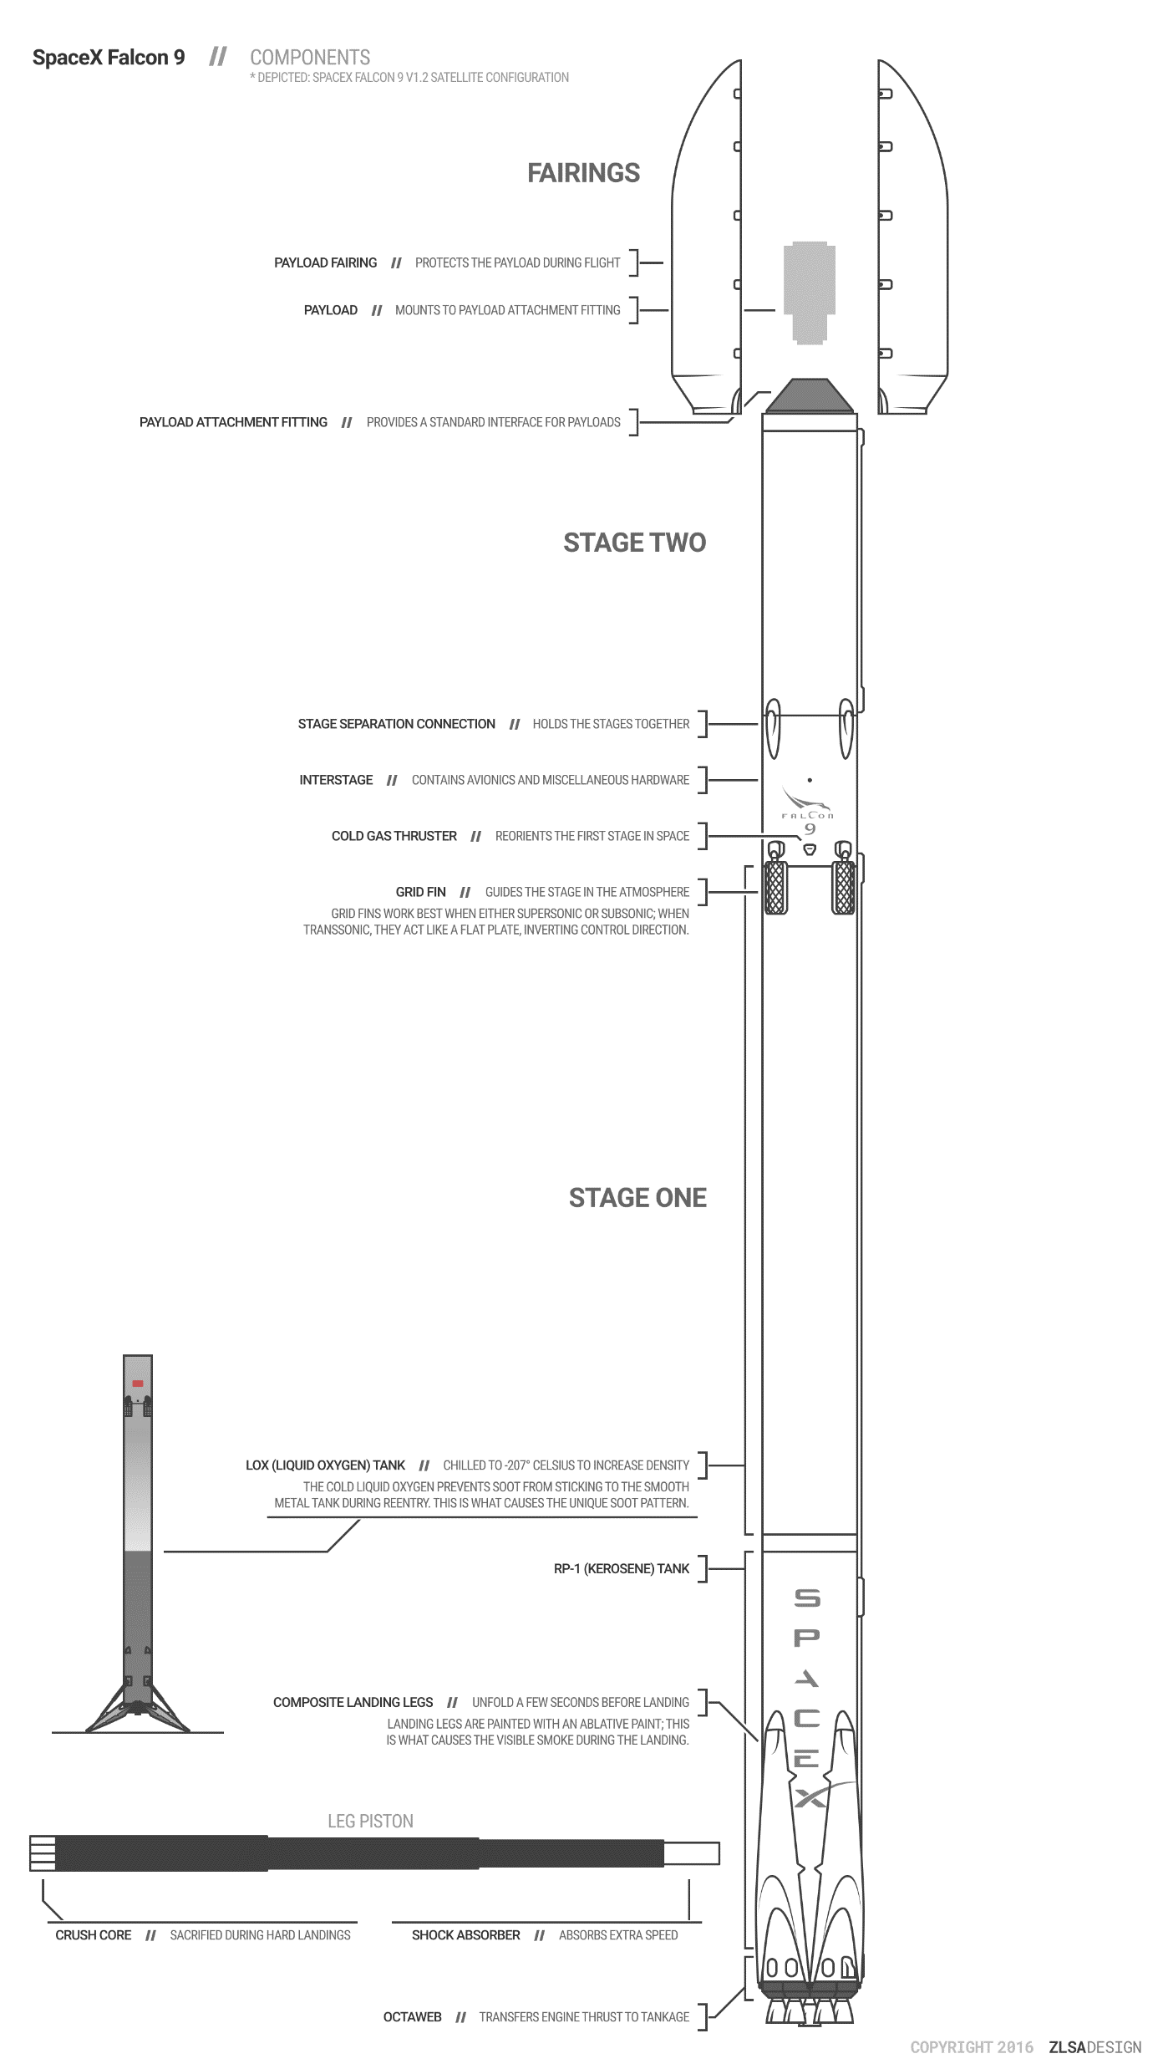

Slide 2
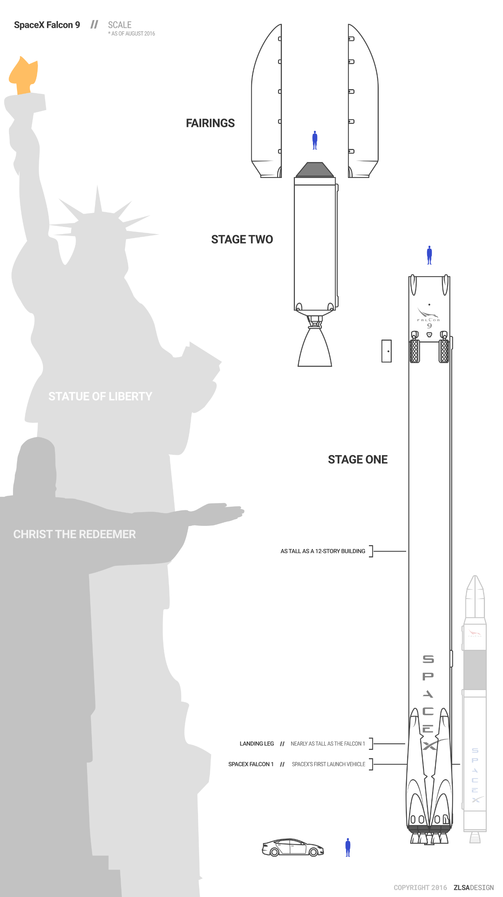
CONTENTS
P3
Executive Summary
P4
Introduction
P6
Methodology
P16
Results
P17
EDA With Visualization
P23
EDA with SQL
P30
Interactive Maps with Folium
P35
Plotly Dash Dashboard
P39
Predictive Analysis
P41
Conclusion

Slide 3
Executive Summary
Methodologies
Data Collection through API (Spacex API) and Webscraping (Wikipedia)
Data Wrangling
Exploratory Data Analysis Using SQL, Pandas and MatPlotlib
Interactive Visual Analytics with Folium
Machine Learning Prediction
Results
Exploratory Data Analysis
Interactive Dashboard ( Screenshots)
Predictive Analysis

Slide 4
INTRODUCTION
Space X announced on its website the launch of the Falcon 9 rocket at a cost of 62 million USD; the other providers cost more than $165 million each, most of the savings comes from Space X being able to reuse the first stage. Therefore, if we can determine whether the first stage will land or not, we can determine the cost of a launch. This information could be used if another company wants to bid on Space X to launch the rocket. The goal of the project is to create a machine learning pipeline to predict whether the first stage will be successful or not.
Problems you want to find answers
Which factors can determine if the rocket will land successfully or not ?
The correlation between different factors that affect the probability of a successful landing.
What operating conditions needs to be in place to ensure a successful landing program?
Does the rate of successful landings increase over the years?

Slide 5
METHODOLOGY

Slide 6
METHODOLOGY
STEPS
Data collection methodology
We collected the data from Wikipedia (Web Scraping) and the SpaceX API
Perform data wrangling
One-hot encoding was applied to categorical features
Perform exploratory data analysis (EDA) using visualization and SQL
Perform interactive visual analytics using Folium and Plotly Dash
Perform predictive analysis using classification models
How to build, tune, evaluate classification models

Slide 7
DATA COLLECTION - API
SPACEX API
REQUEST DATA
DECODE RESPONSE (.JSON NORMALIZE)
REQUEST INFORMATION ABOUT THE LAUCHES
CREATE DICTIONARY
EXPORT DATA TO CSV
REPLACE MISSING VALUES
FILTER THE DATA
CREATE DATAFRAME
SPACEX API
REQUEST DATA
DECODE THE RESPONSE CONTENT AS JSON
CREATE A DATAFRAME USING .json_normalize()
REQUEST INFORMATION ABOUT THE LAUNCHES
REPLACE MISSING VALUES
FILTER THE DATAFRAME TO INCLUDE FALCON 9 LAUNCHES
CREATE A NEW DATAFRAME USING THE DICTIONARY
CREATE A DICTIONARY

